Slide 1
Leadership Exam Study Guide

Slide 2
Jus Ad Bellum
Issue of morality of war is referred to by its Latin name: Jus Ad Bellum, which means "the justice of war”
Just Ad Bellum refers to the question “Under what circumstances is a country justified in going to war?”

Slide 3
Jus In Bello
“Justice in war” is referred to by its Latin name: Jus In Bello.
Just In Bello deals with HOW wars are fought
Who can be attacked
What weapons can be used and in what manner
Treatment of prisoners
Internees and civilians
What is a legitimate target

Slide 4
Check on Learning
Question: What are the 7 criteria under is Jus Ad Bellum?
Answer:
Just Cause
Declared by a proper authority
Right intention
Formal Declaration
Last Resort
Reasonable hope of success
Proportionality

Slide 5
Check on Learning
Question: What are the three key leadership responsibilities derived from the Just War tradition?
Answer:
Educate the soldier in the Laws of War
Enforce the Rules of War
Limit civilian casualties

Slide 6
Check on Learning
What are the 3 steps in internalizing values?
Answer:
Compliance
Identification
Internalization

Slide 7
Ethical Reasoning Process
Step 1. Define the problem
Step 2. Determine relevant principles.
(Rules and Regulations)
Step 3. Develop and evaluate courses of action
Step 4. Choose the course of actions that best
represents Army values

Slide 8
Check on Learning
What are the 4 steps in Ethical Reasoning Process?
Answer:
Step 1. Define the problem
Step 2. Determine relevant principles.
(Rules and Regulations)
Step 3. Develop and evaluate courses of action
Step 4. Choose the course of actions that best
represents Army values

Slide 9
Perspectives to Think About Ethical ProblemConsequences
Virtues
Rules
Consequences

Slide 10
Check On Learning
What Does Unethical Behavior Destroy?
Morale
Cohesion

Slide 11
Army Leadership Requirements Model
BE
DO
KNOW
Notes:
The new Army Leadership Requirements Model shows the leader what attributes he needs to possess and what core leader competencies he needs to use to lead others.
The left side of the model shows the attributes an Army leader needs to excel.
He must BE a leader of character, presence, and intellect. The Army values are the starting point for building character. Leaders must also be empathetic and adopt the Warrior Ethos. These are internal qualities—your true authentic self.
Leader presence is exhibited through military bearing and physical fitness. Leaders should be composed, confident, and resilient through good times and bad.
Intellectual capacity is also crucial and speaks to what a leader should KNOW. They must be mentally agile, have sound judgment and be innovative thinkers.
Army leaders need to use interpersonal tact in dealing with others. They must possess knowledge across both tactical and technical domains including cultural and geo-political awareness.
What a leader must DO is accomplish his mission by leading, developing, and achieving.

Slide 12
Levels of Leadership
Notes:
Let’s take a look at the levels of leadership within the Army. Direct level leadership occurs in the squads, teams, and task forces that make up the bulk of the Army. There are more direct level leadership positions than any other.
Next is the organizational level where systems and processes are developed and refined. And finally there is the strategic level of leadership.

Slide 13
Levels of Leadership
Direct
Organizational
Strategic
Face to face or first-line leadership
Indirect leadership through more levels of subordinates
Major command through Department of Defense level positions
Notes:
Direct level leadership is where subordinates are accustomed to seeing their leaders all the time: teams and squads, sections and platoons, companies and batteries. A direct leader’s span of influence can range from a handful to a several hundred people. NCOs are in direct leadership positions more often than officers and Army civilians and are crucial in the day-to-day development and care of Soldiers.
Organizational leaders influence several hundred to several thousand people. They have staffs to help them lead their people and manage their organizations’ resources.
Strategic level leaders, military and Army civilian, are responsible for large organizations and influence several thousand to hundreds of thousands of people. There are roughly 600 authorized military and civilian positions classified as strategic leaders.

Slide 14
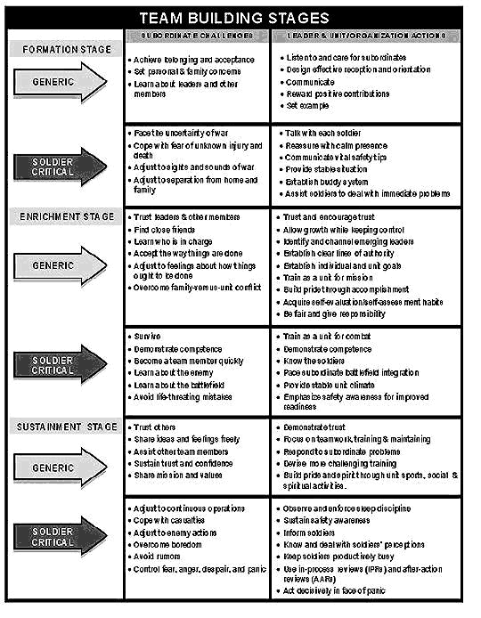
Teambuilding

Slide 15
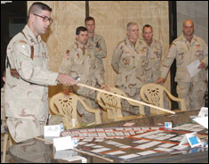
Leader Development
A deliberate, continuous, sequential, and
progressive process grounded in Army values (FM 7-0)
Lifelong learning
Three domains:
Institutional
Operational
Self-development
Requires organizational support
Notes:
Not only must leaders work on developing their own leadership competencies, but they are tasked with developing their subordinates. Leader development is critical to ensure the success of the Army in the long-term.
FM 7-0 defines leader development and lays out the three domains in which it occurs. Using a lifelong learning philosophy, leaders make sure their followers are given the opportunity to learn and develop to meet the future needs of the force.
At both the organizational and strategic levels developing leaders must be part of the commander’s vision and implemented at all levels.
Can you describe how a leader has successfully developed you?
How has that experience impacted you?

Slide 16
Counseling
Provides feedback to subordinate leaders
3 types of counseling
event counseling
performance counseling
professional growth counseling
Counselor should be an active listener, respectful, self-aware and culturally aware, and possess empathy and credibility
Notes:
Counseling is crucial in the leader development process. Counseling provides critical feedback and allows the leader to set goals, offer solutions, and guide the subordinate towards success.
FM 6-22 gives the standards for developmental counseling in Chapter 8 and again in Appendix B.
Sometimes counseling is used in disciplinary actions and can be both positive and negative.
The hard part of counseling is dealing with topics that affect how the person being counseled feels about his/her self. Appendix B of FM 6-22 provides tips on how to counsel others.
What experiences have you had with counseling?
What difficulties have you seen with counseling?

Slide 17
Approaches to Counseling
Direct
Non Direct
Combined

Slide 18
Types of 4856
Performance / Professional
Event Oriented

Slide 19
Components of Adaptability
The ability of a leader to identify the essential elements critical for performance in each new situation.
The ability of a leader to change his practices or his unit by quickly capitalizing on strengths and minimizing weaknesses.
Reference FM 6-22, 10-55, page 10-9

Slide 20
ACHIEVING
From the definition of leadership, achieving is focused on accomplishing the mission. Mission accomplishment is a goal that must co-exist with an extended perspective towards maintaining and building up the organization’s capability for the future. Achieving begins in the short term by setting objectives. In the long term, achieving based on clear vision requires getting results in pursuit of those objectives.
Reference 6-22, 9-1, page 9-1.

